Slide 1
Microsoft PowerApps : Admin in a Day
PRE04

Slide 2
Framing Today
Secure
Monitor
Alert & Action
Deploy
9:00 - 11:40
11:40 - 12:10
1:00 - 2:00
Lunch
2:00 – 4:00
4:00 – 5:30
Welcome & Logistics
Presentation (60)
Questions (15)
Hands on Lab (60)
Questions + Break (20)
Presentation (30)
Questions + Lunch (50)
Hands on Lab (30)
CoE Starter Kit Demo (15)
Questions + Break (15)
Presentation (30)
Questions (15)
Hands on Lab (30)
CoE Starter Kit Demo (15)
Questions + Break (15)
Presentation (15)
Questions (15)
Hands on Lab (30)
Wrap-up (30)

Slide 3
Expertise: Show of Hands
Familiarity with PowerApps 1-5
Not familiar with it yet
Have seen presentations, done trainings, built an app
Have a PowerApps solution in production
Have multiple PowerApps solutions in production
Working on a Centre of Excellence

Slide 4
Job Function: Show of Hands
Job Function 1-5
O365 Admin
D365 Admin
Central IT
Line of Business IT
Power User

Slide 5
Framing Today
Module 1: Secure
Understand the basics of security & administration
Module 2: Monitor
Reporting and telemetry
Module 3: Alert & Action
Action through Automation
Module 4: Deploy
Application Lifecycle Management & Automated Dev Ops

Slide 6
Framing Today
Secure
Monitor
Alert & Action
Deploy
Presentation (60)
Questions (15)
Hands on Lab (60)
Questions + Break (20)
Presentation (30)
Questions + Lunch (50)
Hands on Lab (30)
CoE Starter Kit Demo (15)
Questions + Break (15)
Presentation (30)
Questions (15)
Hands on Lab (30)
CoE Starter Kit Demo (15)
Questions + Break (15)
Presentation (15)
Questions (15)
Hands on Lab (30)
Wrap-up (30)

Slide 7
Overview Presentation
James Oleinik
Director of PM,
PowerApps Administration & Governance

Slide 8
Module 1: Secure

Slide 9
Framing Today
Secure
Monitor
Alert & Action
Deploy
Presentation (60)
Questions (15)
Hands on Lab (60)
Questions + Break (20)
Presentation (30)
Questions + Lunch (50)
Hands on Lab (30)
CoE Starter Kit Demo (15)
Questions + Break (15)
Presentation (30)
Questions (15)
Hands on Lab (30)
CoE Starter Kit Demo (15)
Questions + Break (15)
Presentation (15)
Questions (15)
Hands on Lab (30)
Wrap-up (30)

Slide 10
Hands on Lab Module 1 - Secure (60 minutes)
Lab Pack Download: https://Aka.ms/PowerApps/AppInADay
Objective
Overview of admin tools by exploring our preconfigured lab tenant
Creating and securing an Environment
Understanding and updating DLP policies
Understanding security roles
Notes
Do Not provision a CDS for Apps database in the Personal Productivity (Default) Environment
Use United States (default) region when creating the Environment
Your lab account is an Environment Admin. It does not have Global Admin privileges.
Getting started
In an In-Private browsing session, go to https://admin.powerapps.com
Login with the Lab Admin credentials on your desk

Slide 11
Framing Today
Secure
Monitor
Alert & Action
Deploy
9:00 - 11:40
11:40 - 12:10
1:00 - 2:00
Lunch
2:00 – 4:00
4:00 – 5:30
Welcome & Logistics
Presentation (60)
Questions (15)
Hands on Lab (60)
Questions + Break (20)
Presentation (30)
Questions + Lunch (50)
Hands on Lab (30)
CoE Starter Kit Demo (15)
Questions + Break (15)
Presentation (30)
Questions (15)
Hands on Lab (30)
CoE Starter Kit Demo (15)
Questions + Break (15)
Presentation (15)
Questions (15)
Hands on Lab (30)
Wrap-up (30)

Slide 12
Module 2: Monitor

Slide 13
Framing Today
Secure
Monitor
Alert & Action
Deploy
9:00 - 11:40
11:40 - 12:10
1:00 - 2:00
Lunch
2:00 – 4:00
4:00 – 5:30
Welcome & Logistics
Presentation (60)
Questions (15)
Hands on Lab (60)
Questions + Break (20)
Presentation (30)
Questions + Lunch (50)
Hands on Lab (30)
CoE Starter Kit Demo (15)
Questions + Break (15)
Presentation (30)
Questions (15)
Hands on Lab (30)
CoE Starter Kit Demo (15)
Questions + Break (15)
Presentation (15)
Questions (15)
Hands on Lab (30)
Wrap-up (30)

Slide 14
Monitor Presentation
James Oleinik
Director of PM,
PowerApps Administration & Governance

Slide 15
Lunch
Resume at 1:00 PM

Slide 16
Framing Today
Secure
Monitor
Alert & Action
Deploy
Presentation (60)
Questions (15)
Hands on Lab (60)
Questions + Break (20)
Presentation (30)
Questions + Lunch (50)
Hands on Lab (30)
CoE Starter Kit Demo (15)
Questions + Break (15)
Presentation (30)
Questions (15)
Hands on Lab (30)
CoE Starter Kit Demo (15)
Questions + Break (15)
Presentation (15)
Questions (15)
Hands on Lab (30)
Wrap-up (30)

Slide 17




Admin Management Connectors
Full control
Power Platform APIs in an accessible connector interface, provide admin access to resources
Customization
Build the policies you need to implement administration + governance requirements
Power Platform for Admins
Flow Management
PowerApps for Admins
PowerApps for App Makers

Slide 18
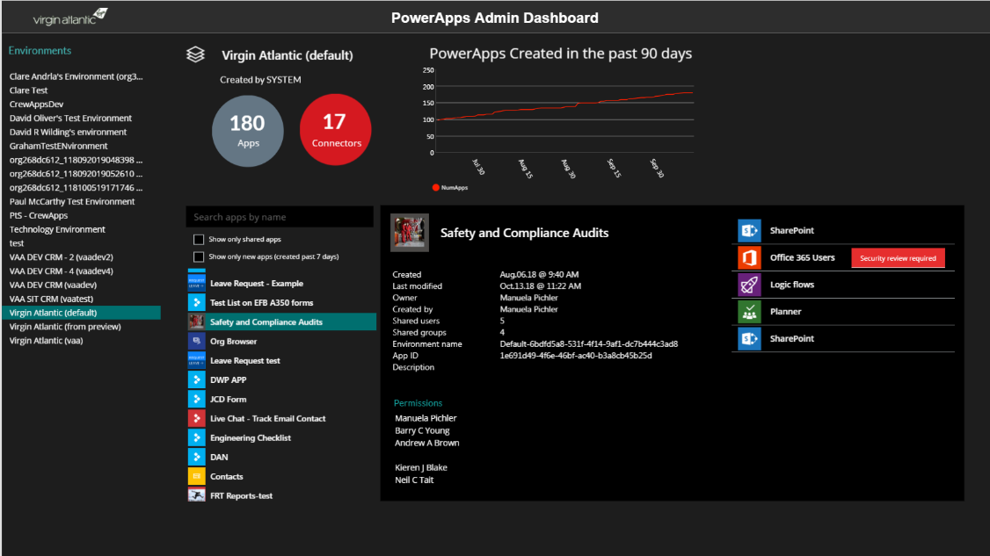
“A PowerApp to rule all PowerApps” (Virgin Atlantic)
Top level stats - # of apps, connectors, and app growth
List of environments
App details
Creator
Date created
Who is the app shared with
Description
…and more
Search and filter
show only shared apps
show new apps
List all connectors used by the app
List all apps in the environment
This is a PowerApp that uses the PowerApps Admin connectors – http://aka.ms/adminconnectors

Slide 19
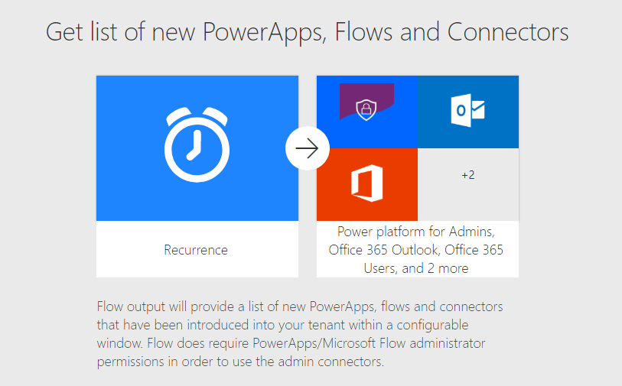
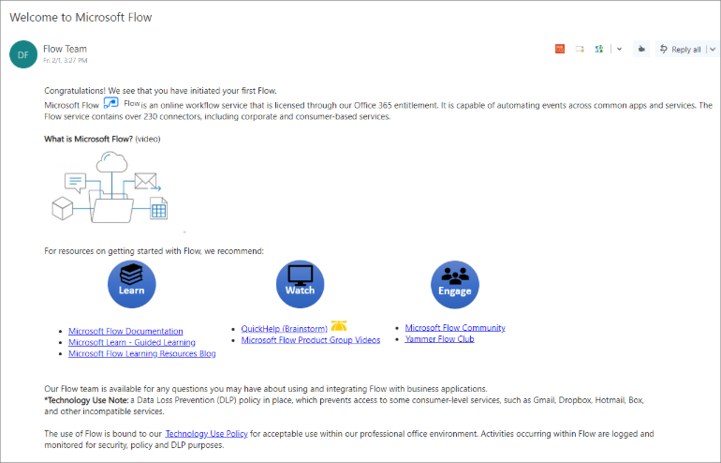
Flow Action through Automation (InterPipeline)
Email Alert to Admins
Welcome email to new Flow Makers

Slide 20
Hands on Lab 2 – Monitoring (30)
Objective
Learn how to enable and make use of monitoring tools, OOB and custom made
PowerApp to monitor activity
Flow to notify admins of activity
Enable and access audit logs
Notes
Audit logging has already been enabled by global tenant admin in the lab tenant
CDS logging is revisited in one of the optional exercises in Module 4
Getting started
In an In-Private browsing session, go to https://make.powerapps.com
Make sure to be logged in with your Lab Admin credentials
Go to your Central Apps Test – Lab Admin environment

Slide 21
Framing Today
Secure
Monitor
Alert & Action
Deploy
Presentation (60)
Questions (15)
Hands on Lab (60)
Questions + Break (20)
Presentation (30)
Questions + Lunch (50)
Hands on Lab (30)
CoE Starter Kit Demo (15)
Questions + Break (15)
Presentation (30)
Questions (15)
Hands on Lab (30)
CoE Starter Kit Demo (15)
Questions + Break (15)
Presentation (15)
Questions (15)
Hands on Lab (30)
Wrap-up (30)

Slide 22

Responsibilities of a Center of Excellence
Administration & Governance
Nurture
Support
Operations

Slide 23
Responsibilities of a Center of Excellence
Administration & Governance
Secure
Monitor
Alert and Act
Nurture
Evangelism and training
Technical guidance
Tools & Components
Support
Operations
Application Lifecycle Management Tools
Infrastructure automations

Slide 24
CoE Starter Kit
Existing Offerings
Admin Centre capabilities
Extensibility via Connectors
Gap Today
A templatized implementation of best practices
Introducing CoE Starter Kit

Slide 25
CoE Starter Kit: Scenarios
Secure
DLP Editor
Monitor
Flow templates to collect data into CDS
Power BI Dashboards
Alert & Action
Maker and Admin notification via Flow templates (Compliance request)
Admin Model Driven App facilitates app audit process
Nurture
App catalog
Welcome email, Internal community channel links

Slide 26
CoE Starter Kit Components List
CDS Entities
Environments, Apps, Flows, Connectors, Connection References, Makers and Audit Logs
Canvas Apps
DLP Editor
Developer Compliance Center
App Catalog
Flows
Sync resources template
Welcome Email
Compliance detail request
Sync audit logs
Model Driven App
+ Business Process Flow for Auditing resources
Power BI Dashboard
Custom Connector for Office 365 Audit Logs
Security Roles

Slide 27
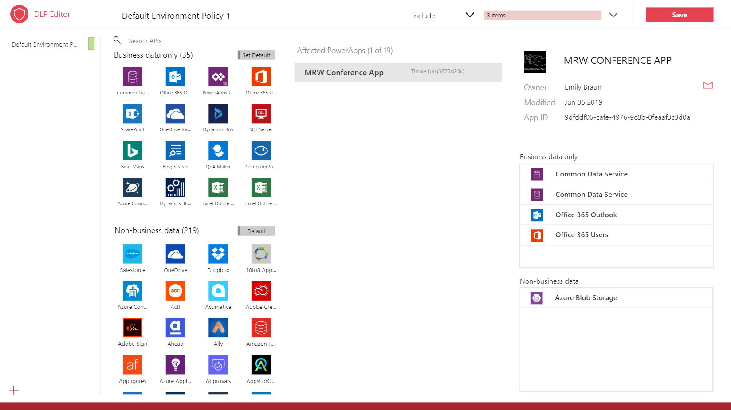
DLP Policy Editor (Secure)
See the impact of a DLP policy and mitigate
vs. breaking the workflow
Update the policy in the app

Slide 28
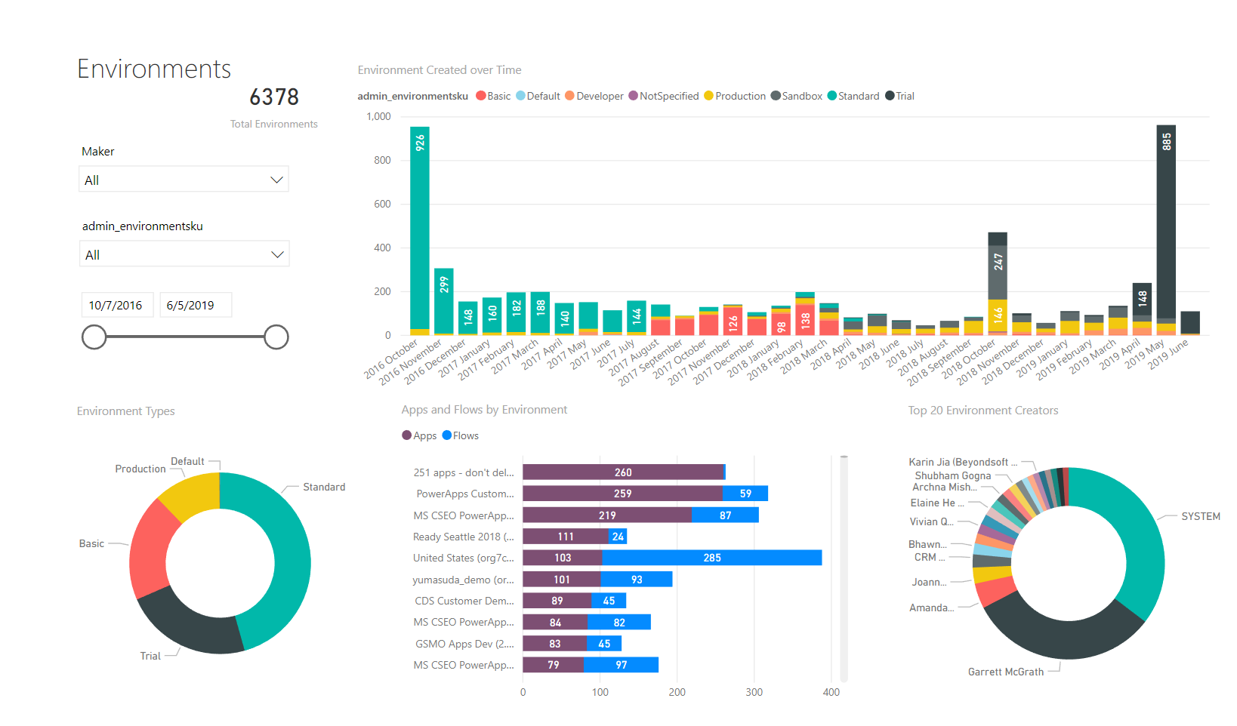
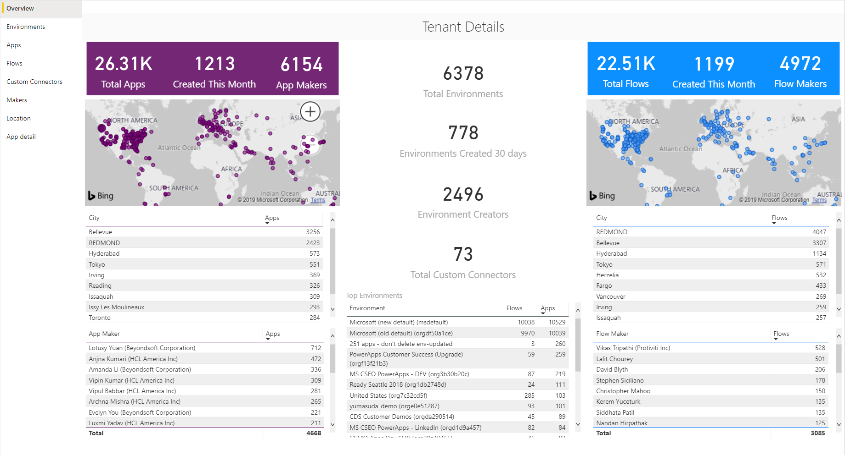
Power BI Dashboard (Monitor)
Gain insight into your tenant
All up view of what’s being created
Discover your champions
Incorporate telemetry

Slide 29
Demo: Advanced Analytics with the CoE Starter Kit
Notes:
Talk to it high level + describe insights

Slide 30
Framing Today
Secure
Monitor
Alert& Action
Deploy
Presentation (60)
Questions (15)
Hands on Lab (60)
Questions + Break (20)
Presentation (30)
Questions + Lunch (50)
Hands on Lab (30)
CoE Starter Kit Demo (15)
Questions + Break (15)
Presentation (30)
Questions (15)
Hands on Lab (30)
CoE Starter Kit Demo (15)
Questions + Break (15)
Presentation (15)
Questions (15)
Hands on Lab (30)
Wrap-up (30)

Slide 31
Module 3: Alert& Action

Slide 32
Framing Today
Secure
Monitor
Alert & Action
Deploy
9:00 - 11:40
11:40 - 12:10
1:00 - 2:00
Lunch
2:00 – 4:00
4:00 – 5:30
Welcome & Logistics
Presentation (60)
Questions (15)
Hands on Lab (60)
Questions + Break (20)
Presentation (30)
Questions + Lunch (50)
Hands on Lab (30)
CoE Starter Kit Demo (15)
Questions + Break (15)
Presentation (30)
Questions (15)
Hands on Lab (30)
CoE Starter Kit Demo (15)
Questions + Break (15)
Presentation (15)
Questions (15)
Hands on Lab (30)
Wrap-up (30)

Slide 33
Alert& Action Presentation
James Oleinik
Director of PM,
PowerApps Administration & Governance

Slide 34
Framing Today
Secure
Monitor
Alert & Action
Deploy
Presentation (60)
Questions (15)
Hands on Lab (60)
Questions + Break (20)
Presentation (30)
Questions + Lunch (50)
Hands on Lab (30)
CoE Starter Kit Demo (15)
Questions + Break (15)
Presentation (30)
Questions (15)
Hands on Lab (30)
CoE Starter Kit Demo (15)
Questions + Break (15)
Presentation (15)
Questions (15)
Hands on Lab (30)
Wrap-up (30)

Slide 35
Hands on Lab 3 – Action through Automation
Objective
Automate Environment request and creation with a Flow + Microsoft Forms
Nurture users to help adopt the Power Platform with a Flow that welcomes new makers
Notes
In the Flow, Environment location needs to be lower case (e.g., ‘unitedstates’).
Database creation: 1033 == English language
Getting started
In an In-Private browsing session, go to https://forms.microsoft.com
Make sure to be logged in with your Lab Admin credentials

Slide 36
Framing Today
Secure
Monitor
Alert & Action
Deploy
Presentation (60)
Questions (15)
Hands on Lab (60)
Questions + Break (20)
Presentation (30)
Questions + Lunch (50)
Hands on Lab (30)
CoE Starter Kit Demo (15)
Questions + Break (15)
Presentation (30)
Questions (15)
Hands on Lab (30)
CoE Starter Kit Demo (15)
Questions + Break (15)
Presentation (15)
Questions (15)
Hands on Lab (30)
Wrap-up (30)

Slide 37
Demo: Advanced Automation with the CoE Starter Kit

Slide 38
Framing Today
Secure
Monitor
Alert & Action
Deploy
9:00 - 11:40
11:40 - 12:10
1:00 - 2:00
Lunch
2:00 – 4:00
4:00 – 5:30
Welcome & Logistics
Presentation (60)
Questions (15)
Hands on Lab (60)
Questions + Break (20)
Presentation (30)
Questions + Lunch (50)
Hands on Lab (30)
CoE Starter Kit Demo (15)
Questions + Break (15)
Presentation (30)
Questions (15)
Hands on Lab (30)
CoE Starter Kit Demo (15)
Questions + Break (15)
Presentation (15)
Questions (15)
Hands on Lab (30)
Wrap-up (30)

Slide 39
Module 4: Deploy
Evan Chaki
Principal GPM
Per Mikkelsen
Principal Program Manager
PowerApps ALM

Slide 40
Framing Today
Secure
Monitor
Alert & Action
Deploy
Presentation (60)
Questions (15)
Hands on Lab (60)
Questions + Break (20)
Presentation (30)
Questions + Lunch (50)
Hands on Lab (30)
CoE Starter Kit Demo (15)
Questions + Break (15)
Presentation (30)
Questions (15)
Hands on Lab (30)
CoE Starter Kit Demo (15)
Questions + Break (15)
Presentation (15)
Questions (15)
Hands on Lab (30)
Wrap-up (30)

Slide 41
Hands on Lab 4 – Deploying apps
Objective
Deploy the Device Ordering Development team’s solution into Test
Export/Import the solution, then grant access to the appropriate end users.
Optional exercises deploy Flow, configure a service principal account, and review CDS logs
Notes
Download Managed solution for deploying to test, Unmanaged for keeping an editable copy of the solution. This is good practice to follow.
In Exercise 3, start portal in preview mode by going to https://make.preview.powerapps.com
Getting started
In an In-Private browsing session, go to https://make.powerapps.com
Make sure to be logged in with your Lab Admin credentials
Go to the Device Ordering Development environment and export the Contoso Device Order Management solution

Slide 42
Framing Today
Secure
Monitor
Alert & Action
Deploy
Presentation (60)
Questions (15)
Hands on Lab (60)
Questions + Break (20)
Presentation (30)
Questions + Lunch (50)
Hands on Lab (30)
CoE Starter Kit Demo (15)
Questions + Break (15)
Presentation (30)
Questions (15)
Hands on Lab (30)
CoE Starter Kit Demo (15)
Questions + Break (15)
Presentation (15)
Questions (15)
Hands on Lab (30)
Wrap-up (30)

Slide 43
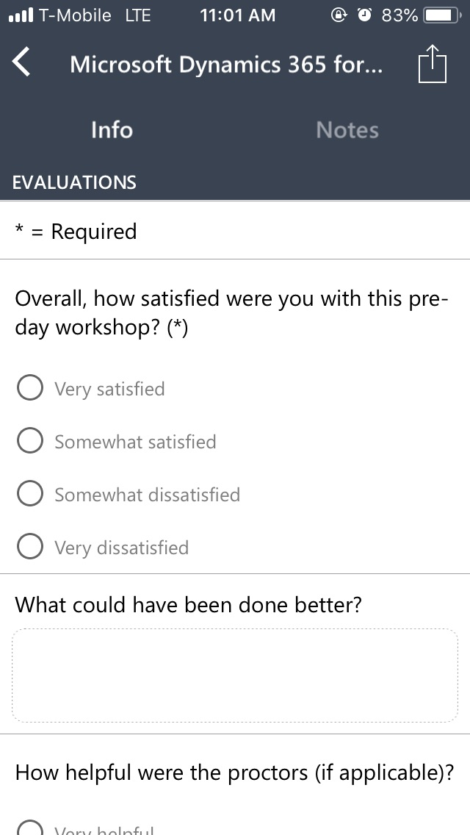
Evaluate this session
Complete your session and conference evaluations through the mobile app or https://aka.ms/MBASeventapp
Please select Microsoft Business Applications Summit from the menu of events and then log in with your registration credentials

